Slide 3


Gustavo Velez
MVP SharePoint Server
http://www.gavd.net
gustavo@gavd.net

Slide 4


Fabian Imaz
SiderysBsn
Arquitecto
MVP SharePoint Server
http://www.siderysbsn.com
http://blog.siderys.com
@fabianimaz

Slide 5
Introducción al Modelo de Add-In para Office

Slide 6
Introducción

Slide 7
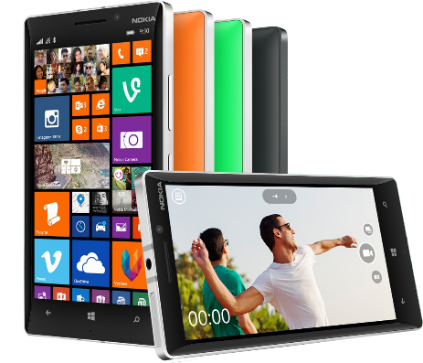


Plataforma desarrollo Office 365
Contextual apps
Robust Office 365 APIs
Flexible tools
Documents
Search
Mail
Social
Calendar
People
Notes:
Two kinds of apps :
you light up Office/Exchange/SharePoint.
You consume our services in a custom (device or web) app
Contextual apps
Rich, powerful interactive IW experiences
Do more, without leaving Excel, Outlook, PowerPoint, SharePoint
Consistent Framework everywhere that Office runs. Everywhere that people do work
Robust APIs
Big news
More for SharePoint Devs
Growing up outside SharePoint
Flexible Tools
Open-ness and choice is a core pillar
But … we just want to take away all the friction
Tools targeted to specific users
Platforms with best management, capability and scale
What does this mean. Where is the value
Breadth : more endpoints and experiences
Depth: richer APIs. More capabilities
Power:

Slide 8
Opciones de desarrollo
Pre-Office 2013 development
Office 2013 desktop apps
Office 2013 web apps
Extending Office ribbon
Task pane app
Content app
COM add-in
Content app
Mail app
Macro
Mail app
VSTO
Notes:
As previously covered, Office 2013 will continue to support the pre-Office 2013 extensibility models including Macros, COM Add-Ins, Ribbon customizations and those customizations built using the Visual Studio Tools for Office (VSTO).
The new model in Office 2013 of building apps includes three different types of apps for Office:
Task Pane: A Task Pane app, available in the Word, Excel & Project Office 2013 desktop clients and the Excel Office 2013 Web client, involves creating a task pane that runs in the left or right margin of the application. This type of extensibility option is a great solution when creating reference or lookup solutions within an application.
Content: A Content app, available in the Excel Office 2013 desktop & web clients, involves adding content to a document. For instance, an Excel workbook could contain a list of stores with their addresses for a sales report. A content app within the workbook could show a map from Bing with pushpins for each of the sales locations.
Mail: A Mail app, available in the Outlook Office 2013 desktop & web clients involves adding additional content based on the context of an item in Outlook. For instance an app could show a map from Bing Maps if it detects a physical address within an email.

Slide 9
Escenarios de ejemplo Apps para Office 2013
Rich web content
YouTube video and photo gallery
Content authoring
Resumes and contracts
Business processes
Sales and marketing, finance, and HR
Data visualization, analysis and mashups
Maps, custom charts, and lookups
Dashboards
Data analysis and data mashups
Team collaboration
Content and project management
Reference tools
Translation, definitions, dictionary, help, research
Forms and
reports
Legal forms and financial reports
Workflow
Document approval and expenses
Content authoring and publishing
Doc builders and print services
App for SharePoint
Contextual content and services
Business data lookup (CRM), contextual forms (surveys)
Document template
Document template
Workflow and collaboration
Project tracking, coauthoring
App for Office
App for Office
App for Office
App for Office
App for Office
App for Office
App for Office
App for Office
App for Office
Notes:
Office 2013 introduces a new extensibility option for developers to create custom business solutions. Developers can build an app for Office, new to Office 2013, to enhance the experience when users are working within Office 2013 clients. Unlike previous extensibility models in Office, apps for Office are founded on Web technologies and therefore, depending on the type of app, can be used in both the Office 2013 desktop clients as well as the online clients.
There are three different high-level scenarios that this new model supports. Each builds on the previous scenario:
App for Office: This is the smallest unit of customization. Developers can build one of three types of Apps (Task Pane, Content or Contextual). These can be embedded within an Office application or within an Office document.
Document Template: A document template could consist of multiple apps installed in the template document, or require an app to be installed in the hosting application.
App for SharePoint: SharePoint apps can contain one or more document templates which in turn contain apps for Office.
The slide contains numerous examples of each extensibility scenario.

Slide 10
Arquitectura y tipos de Apps

Slide 11
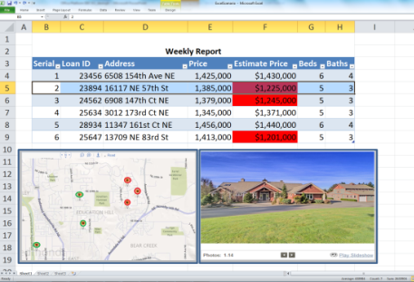

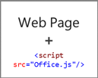
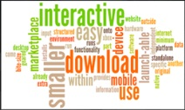

Anatomía de una App para Office
Web server
Office Store or
SharePoint app catalog

Slide 12
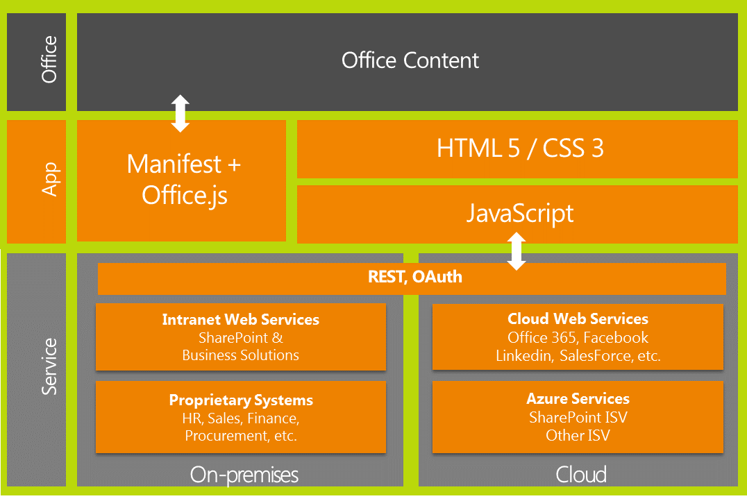
Arquitectura de las aplicaciones Office
Notes:
REST – motor de consultas para acceder a los datos
Odata – generador de consultas
Oauth – mecanismo de autenticación para validar las credenciales del usuario
Office.js – Expone el modelo de Objeto de Officed

Slide 13
Tipos de App para Office
Panel de Tareas
App adjunta al documento
Contenido
App en el cuerpo del documento
Mail Inline pane en un email o cita

Slide 14
Tipos de App para Office
Panel de Tareas
App adjunta al documento
Contenido
App en el cuerpo del documento
Mail Inline pane en un email o cita

Slide 15
Tipos de App para Office
Panel de Tareas
App adjunta al documento
Contenido
App en el cuerpo del documento
Mail Inline pane en un email o cita

Slide 16
Demo: Desplegando aplicaciones desde la tienda

Slide 17
Desarrollando una App

Slide 18
Como crear una aplicación
Herramientas y Framework’s
Lenguaje
Capa de datos
Visual Studio 2013 - 2015
JavaScript
Office, documentos
NAPA
Todas las aplicaciones
Servicios Externos
Plantillas diseñadas
Despliegue en Office, Nube y cliente
Manifiesto y publicación
API Office (JavaScript)
jQuery y otros Framework’s
REST
oData
Almacenar valores en el contexto del documento
Bases de datos expuestas como servicios
Servicios en la nube

Slide 19




Distribución, la tienda y el catalogo privado
Panel del Vendedor
Cuenta Autorizada
Store
Evaluación
Venta
Ribbon
Usuario Final
Validación
Aplicación
Direct
SharePoint
Online / Onpremise
Catalogo
Aplicaciones
IT admin

Slide 20
Demo: Desarrollando Apps

Slide 21
Gustavo Velez
MVP SharePoint Server
http://www.gavd.net
gustavo@gavd.net

Slide 22
Fabian Imaz
SiderysBsn
Arquitecto
MVP SharePoint Server
http://www.siderysbsn.com
http://blog.siderys.com
@fabianimaz

